Slide 1
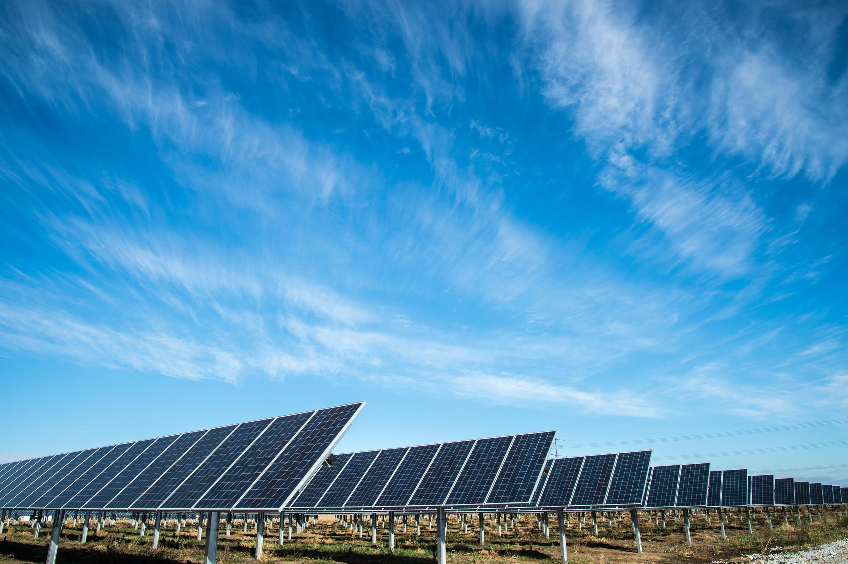
Team Zero
Amin Mansouri
Jefry el Bhwash
Levy Duivenvoorden
Niels van Drunen
Niels van Schaik

Slide 2
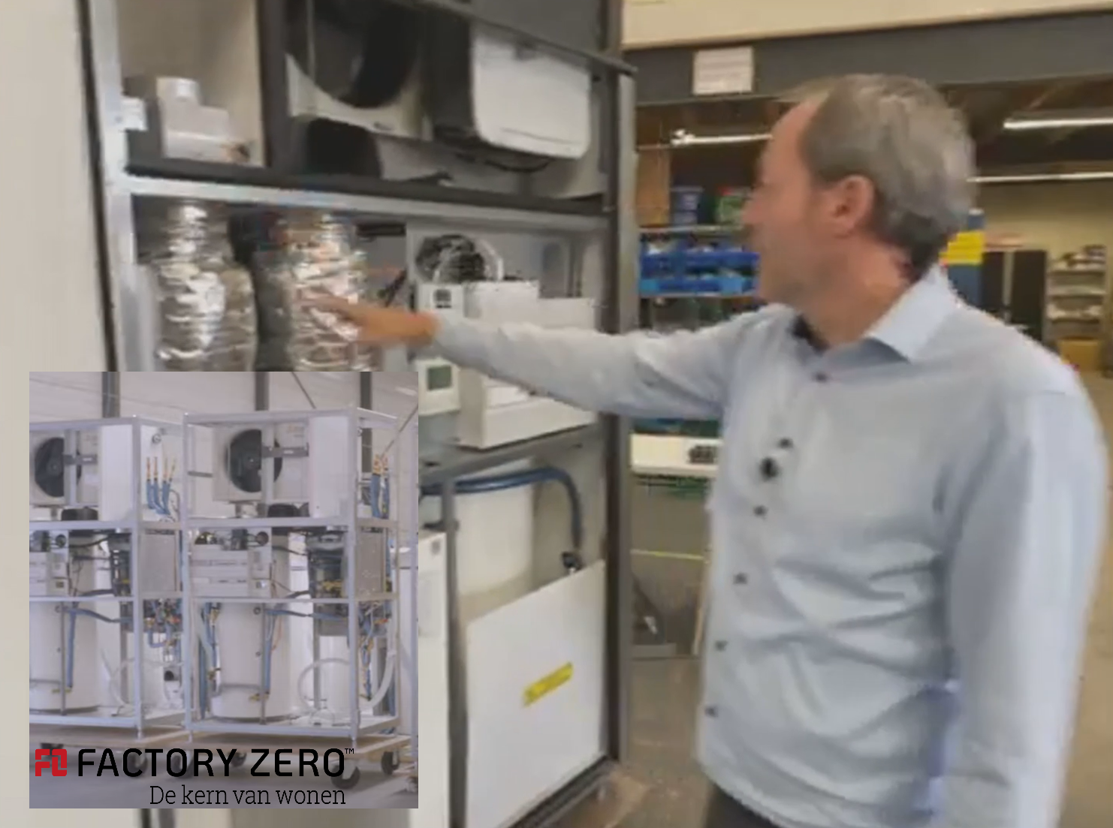

Slide 3
Research Question
What is a suitable machine learning model to predict energy use and production of a “zero at the meter” house, one day in advance with hourly resolution?
And perhaps…
When to store or sell the produced solar energy to maximise the profit of the user?

Slide 4
Where we left off… (since last public presentation)
Weather predictions
Start working with energy consumption
Make a heatmap that focusses on the calmer parts of the data
SVR (regression model) to keep as a baseline check (10 day interval)
LSTM (neural network)

Slide 5
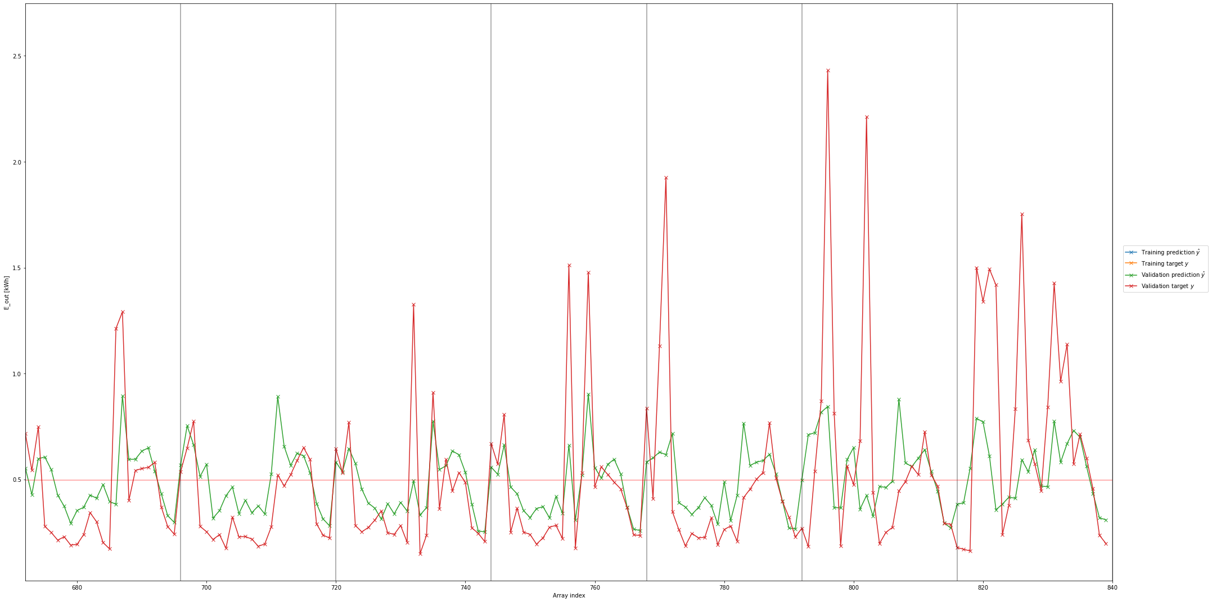
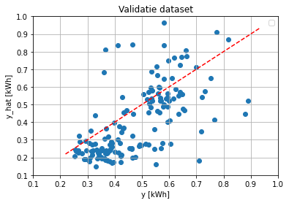
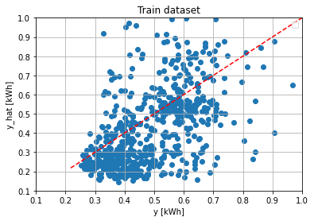
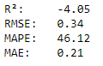
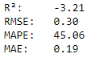
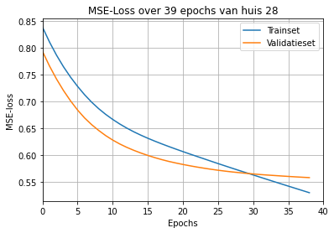
Multi Layer Perceptron (neural network)
Features:
Hour of the day [0,1,2…23]
Energy consumption 1, 2, 3 & 7 days in the past
Average energy consumption daily & weekly
Trained on [ 2019-09-02 : 2019-09-30 ] (4 weeks)
Validated on [ 2019-09-30 : 2019-10-06 ] (1 week)
Tested on [ 2019-10-06 : 2019-10-13 ] (1 week)

Slide 6
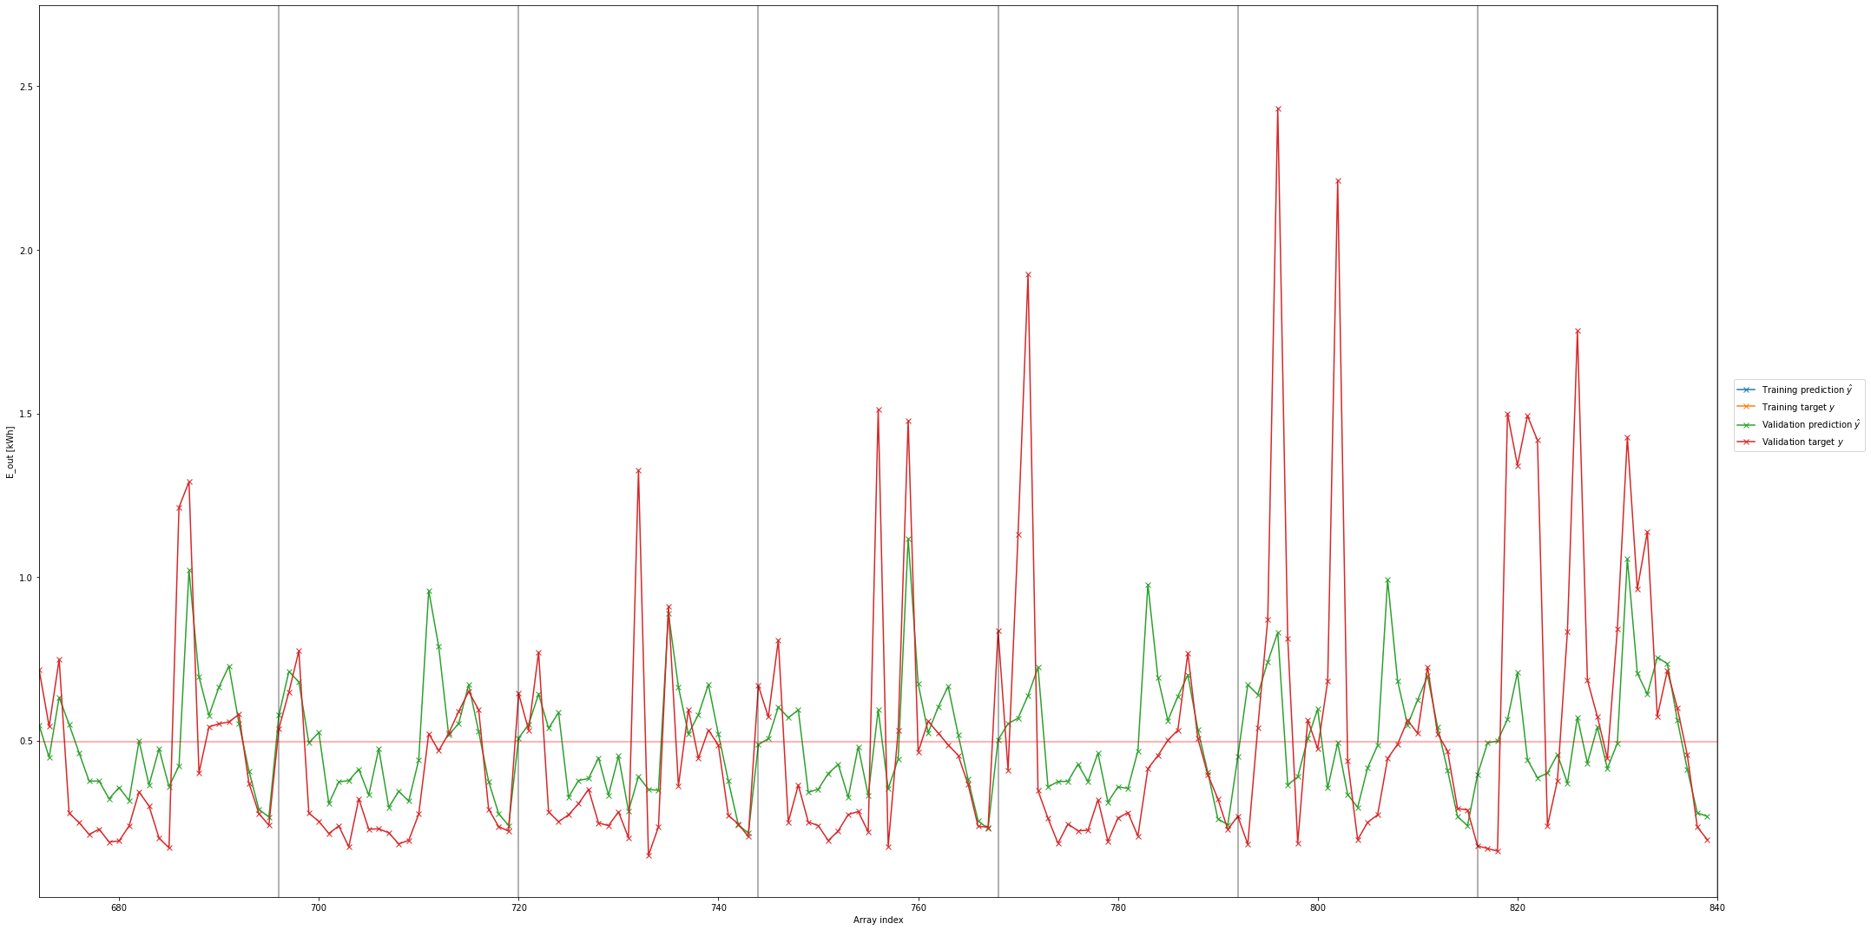
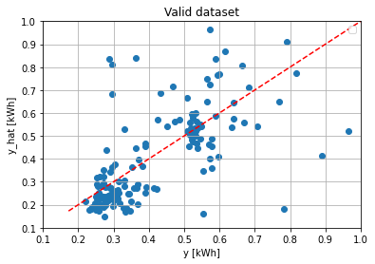
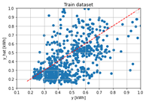
MVLR (machine learning)
R²: -3.02
RMSE: 0.35
MAPE: 46.99
MAE: 0.21
R²: -2.07
RMSE: 0.30
MAPE: 45.25
MAE: 0.19
Features:
Hour of the day [0,1,2…23]
Energy consumption 1, 2, 3 & 7 days in the past
Average energy consumption daily & weekly
Trained on [ 2019-09-02 : 2019-09-30 ] (4 weeks)
Validated on [ 2019-09-30 : 2019-10-06 ] (1 week)
Tested on [ 2019-10-06 : 2019-10-13 ] (1 week)

Slide 7
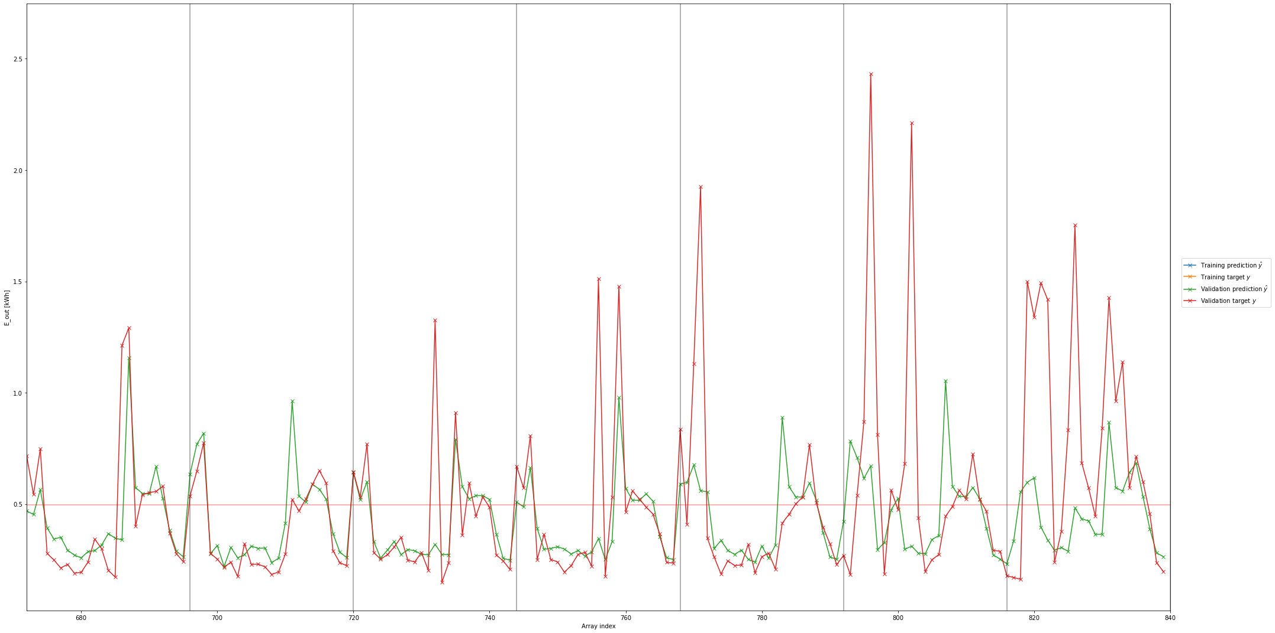
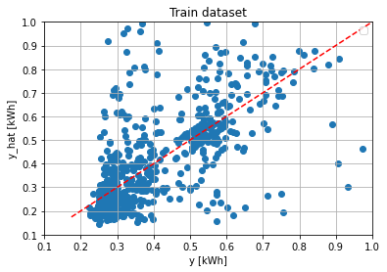

SVR (machine learning)
Valid dataset
R²: -3.06
RMSE: 0.36
MAPE: 64.52
MAE: 0.19
R²: -2.04
RMSE: 0.30
MAPE: 59.06
MAE: 0.16
Features:
Hour of the day [0,1,2…23]
Energy consumption 1, 2, 3 & 7 days in the past
Average energy consumption daily & weekly
Trained on [ 2019-09-02 : 2019-09-30 ] (4 weeks)
Validated on [ 2019-09-30 : 2019-10-06 ] (1 week)
Tested on [ 2019-10-06 : 2019-10-13 ] (1 week)

Slide 8
Future
Make a model that can effectively classify peaks in the energy consumption data and knows how to deal with them.
Make further progress with writing our paper, methodology chapter is up next.

Slide 9

Remarks, Suggestions, Questions

